Slide 1
Diagrams
Package and Deployment Diagram

Slide 2
Package Diagram
Packages/namespaces are used to organize classes in a large application.
This reduces the complexity pf understanding the architecture of the application
UML provides packages to model o group of classes.
The packages are places in a package diagram along with their dependencies
The are part of the development view

Slide 3
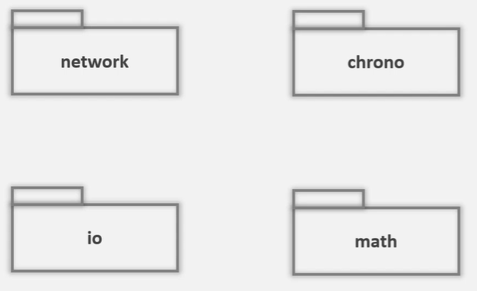
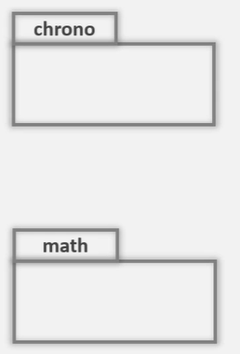
Package

Slide 4
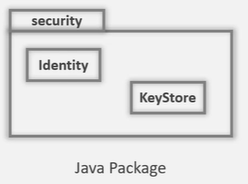
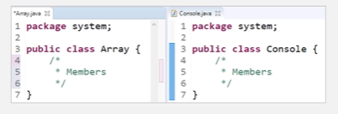
Package content
A package organizes UML elements
These elements can be drawn inside the package

Slide 5
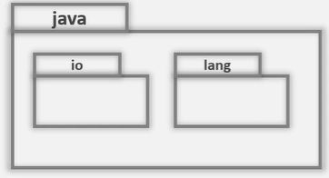
Nested Packages
Packages can be nested
This allows us to model the deep nesting of the packages in large applications

Slide 6
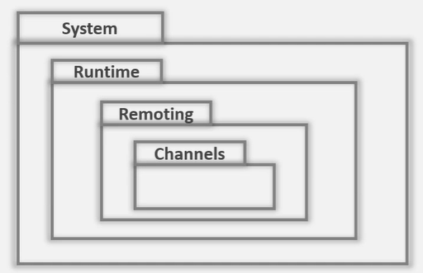
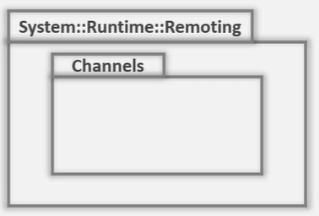
Nested Packages

Slide 7
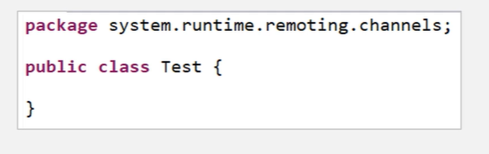

Slide 8
Element Visibility
The elements inside the packages can have two of visibility
Private:
Elements with public visibility can be used outside the package
Public:
Elements with the private visibility can be used only by elements of the same package
Public visibility uses the + sign & private visibility use - sign

Slide 9
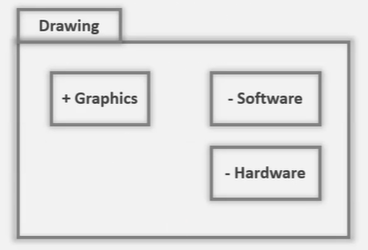
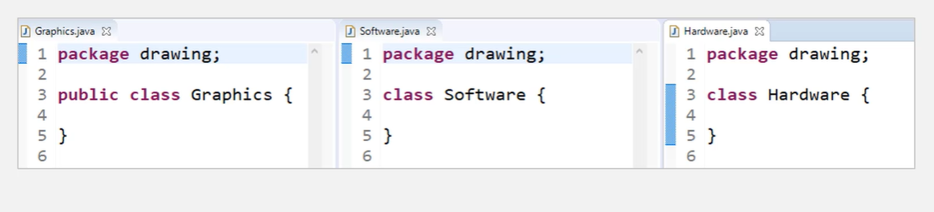
Example

Slide 10
Importing Packages
To access an element in another package, you have to use full scoped names
Alternatively, a package can be imported that causes all the public elements to be available without using full scoped names
The imported packages is called target packages
The import creates a dependency & is shown with a dashed arrow
The arrow points to the target packages & uses <<import>> stereotype
A package can import a specific element of the whole
Note that element should be public

Slide 11
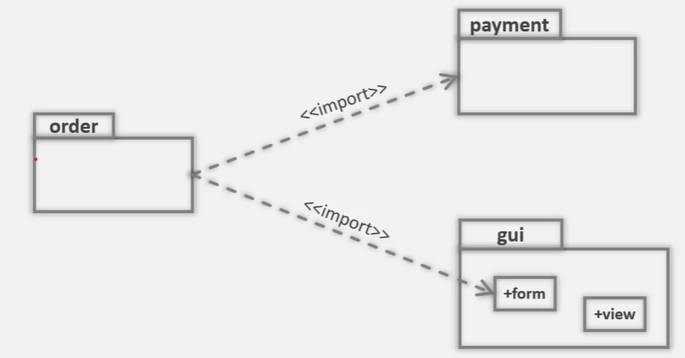
Import

Slide 12
Import
The import relation itself has visibility
An import can be public import or private import
In public import, elements have public visibility inside the importin pancakes
To avoid exposing the imported packages elements, you can use private import by specifying <<access>> stereotype

Slide 13
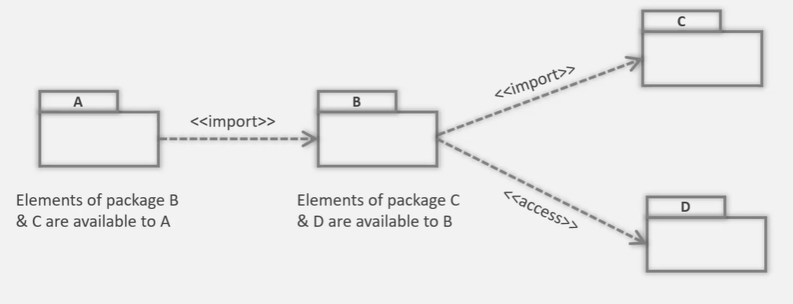
Example

Slide 14
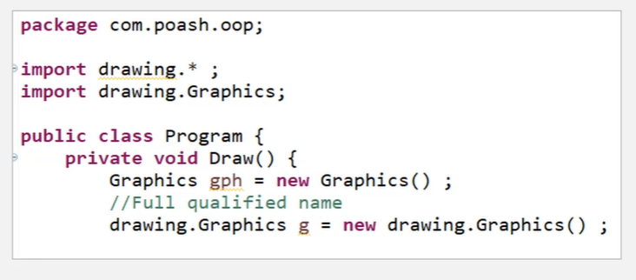

Slide 15
When to use?
To show high-level view of the system
The view could be requirements or design
Organize the complexity by dividing the system into modules
Keep track of dependencies
Understand how major parts of the system relate to each other

Slide 16
Deployment Diagram
Represents the physical view in Kruchen’s 4+1 model
Concerned with the physical elements of the system
These elements are executable files and the hardware they run on
Describes the elements, where they are located on the hardware and how the communicate with each other

Slide 17
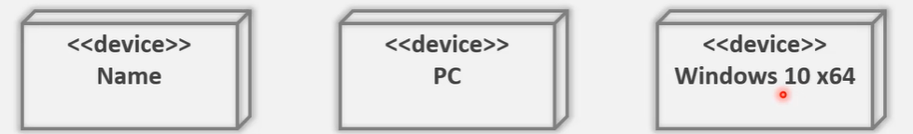
Node
The core part in a deployment diagram is a node
It shows the computer hardware and is shown in a 3D box with <<device>> stereotype and a name
The name can be general or specific name i.e. PC is general name, but windows 10 x64 is a specific name

Slide 18
Node
Nodes don’t need to represent a hardware
Some type of the software provide an execution environment in which other software components can be executed
So, a node can be hardware or software resources that can host software or related files
A software node can be an application context
Generally not part of the software that is developed
Provide by a third-[arty that provides services to our software
Examples of such execution environments are OS, Web server, Docker, App server, etc.

Slide 19
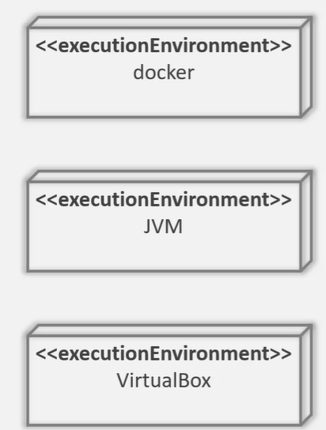
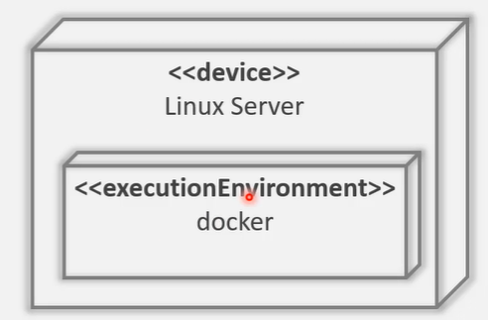
Example

Slide 20
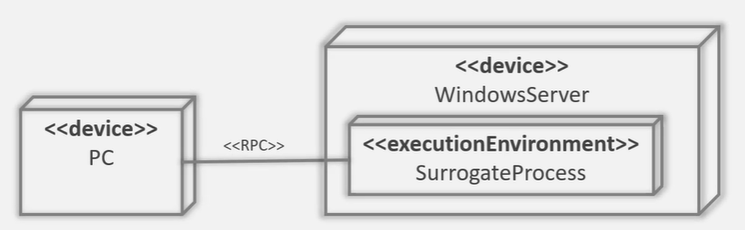
Node Communication
A node may have to communicate with other nodes to fulfil its tasks
This is shown through communication oaths; a solid line that connects two nodes
The type of communication is shown through a stereotype

Slide 21
Artifacts
An artifact is a physical file that is generated pout of software development process
An artifact can be of the following type
Executable, such as .exe or .jar file
Libraries, such as .lib, .dll
Source files, such as .cpp, .java
Configuration files used by software att runtime, such as .xml or .ini

Slide 22
Artifacts
UML provides multiple notations for represents artifacts
Artifacts are represented in a rectangle
With the <<artifact>> stereotype
With a document icon in the top right corner
With a dependency arrow towards the node
If there are too many artifacts, you can list them directly inside a node
You can also show dependency between artifacts through a dependency arrow

Slide 23
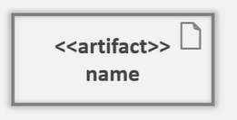
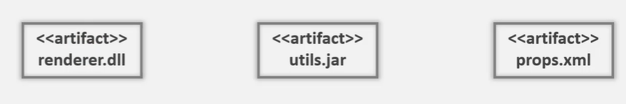
Example

Slide 24
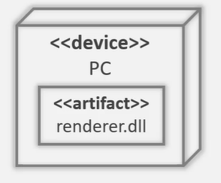
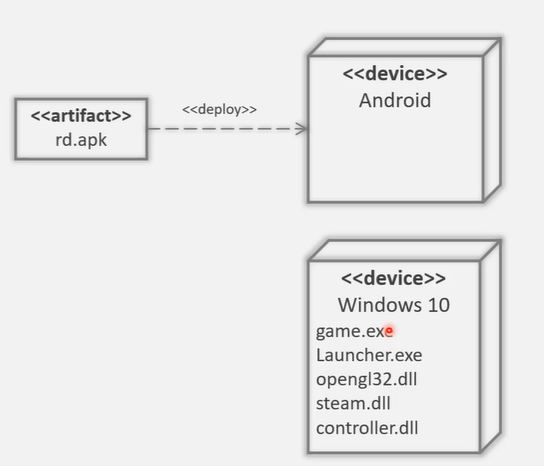
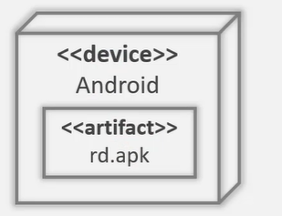
Example

Slide 25
Artifacts
Software can be modularized through packages or components
These are ultimately complied into one or more files or artifacts
If an artifact is physical representation of a component, then the artifact manifest that component
Note that artifact can manifest a class, package or a component
This relationship is shown through a dependency arrow with <<manifest>> stereotype

Slide 26
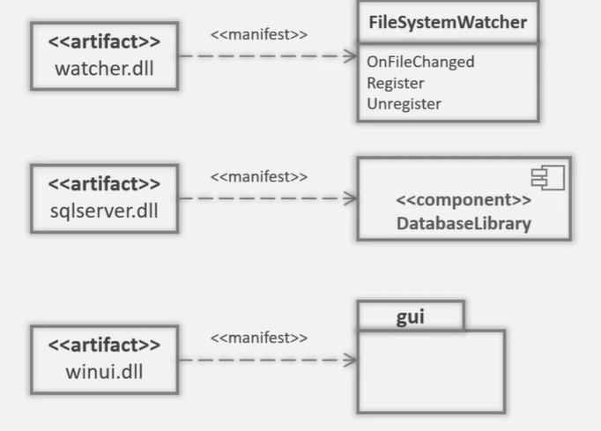
Example

Slide 27
Advantages
Useful in all stages of the design process
Especially, in the earlier stages, you can get an overview of the architecture of the system without dealing with details
A rough sketch can be v=created that can be refined in the later stages of the software development
The refinement can help express the current view of the physical system with other stakeholders

Slide 28
When to use?
Create rough sketch of the physical layout of the system
Discover issued involved in deployment process
Identify & explore dependencies between your software & its environment
Visualize the physical topology of the system's deployment

